Slide 1



Slide 2

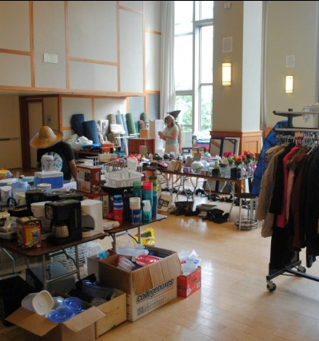
Existing System
Every year before the commencement of new Semester, NU has an event called ‘Trash2Treasure’.
One student’s trash becomes another’s treasure.
Each and every student waits for this event to buy the stuff they require to make a home.
Students form a queue since 6 AM in the morning and this continues till late afternoon.
Eventually, they spend almost half of the day here, carry the stuff and go to their respective houses.

Slide 3
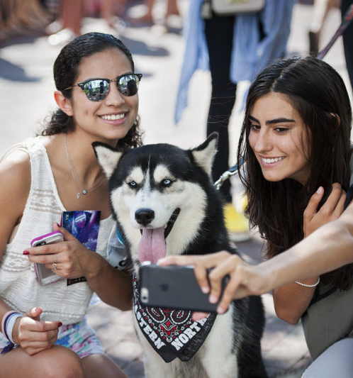
New Student? Not a problem!
There is always a dilemma in new students about where to go and what to do for any work at the University.
They generally take help from the seniors.
But if there is an App which can help them, they don’t really need to ask anyone what to do.
They will find the answers themselves using the App.

Slide 4
Project Summary
We are designing the layout of the Mobile application for Northeastern University’s students.
The App is for the event ‘Trash to Treasure’ which takes place every fall and spring before new students join.
NU students can post the items that they are not using anymore for sale.
The items could be anything right from tables, organizers to jackets or shoes. Sign up and login will be valid only for students possessing active husky ids.
This App will help the students to sell and purchase items online at a reasonable price and will prevent students from forming big queues early in the morning.

Slide 5

PROBLEMS FACED
Tiring queues
Better early, than late
New in the city
Cashless: Not allowed

Slide 6
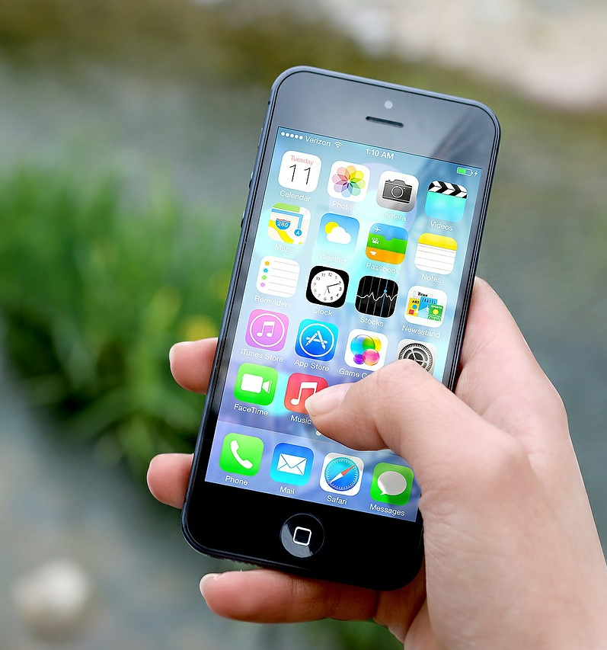
Solutions Provided
Just a phone needed
Everything Online

Slide 7
STRATEGY PLANE

Slide 8
Speedy page loading
Attractive and easy to navigate web store design
You have 10 sec to leave an impression on an online visitor and tell them what they will get out of your website and company. After this time (and oftentimes before), they will leave.
44% Of people will switch devices if content takes too long to load
39% Will stop engaging altogether
Simple checkout
Visible contact information
37% Of visitor will leave the website if there is no contact information or contact number
84% Of online shoppers abandon complicated online checkouts

Slide 9
PERSONAS

Slide 10
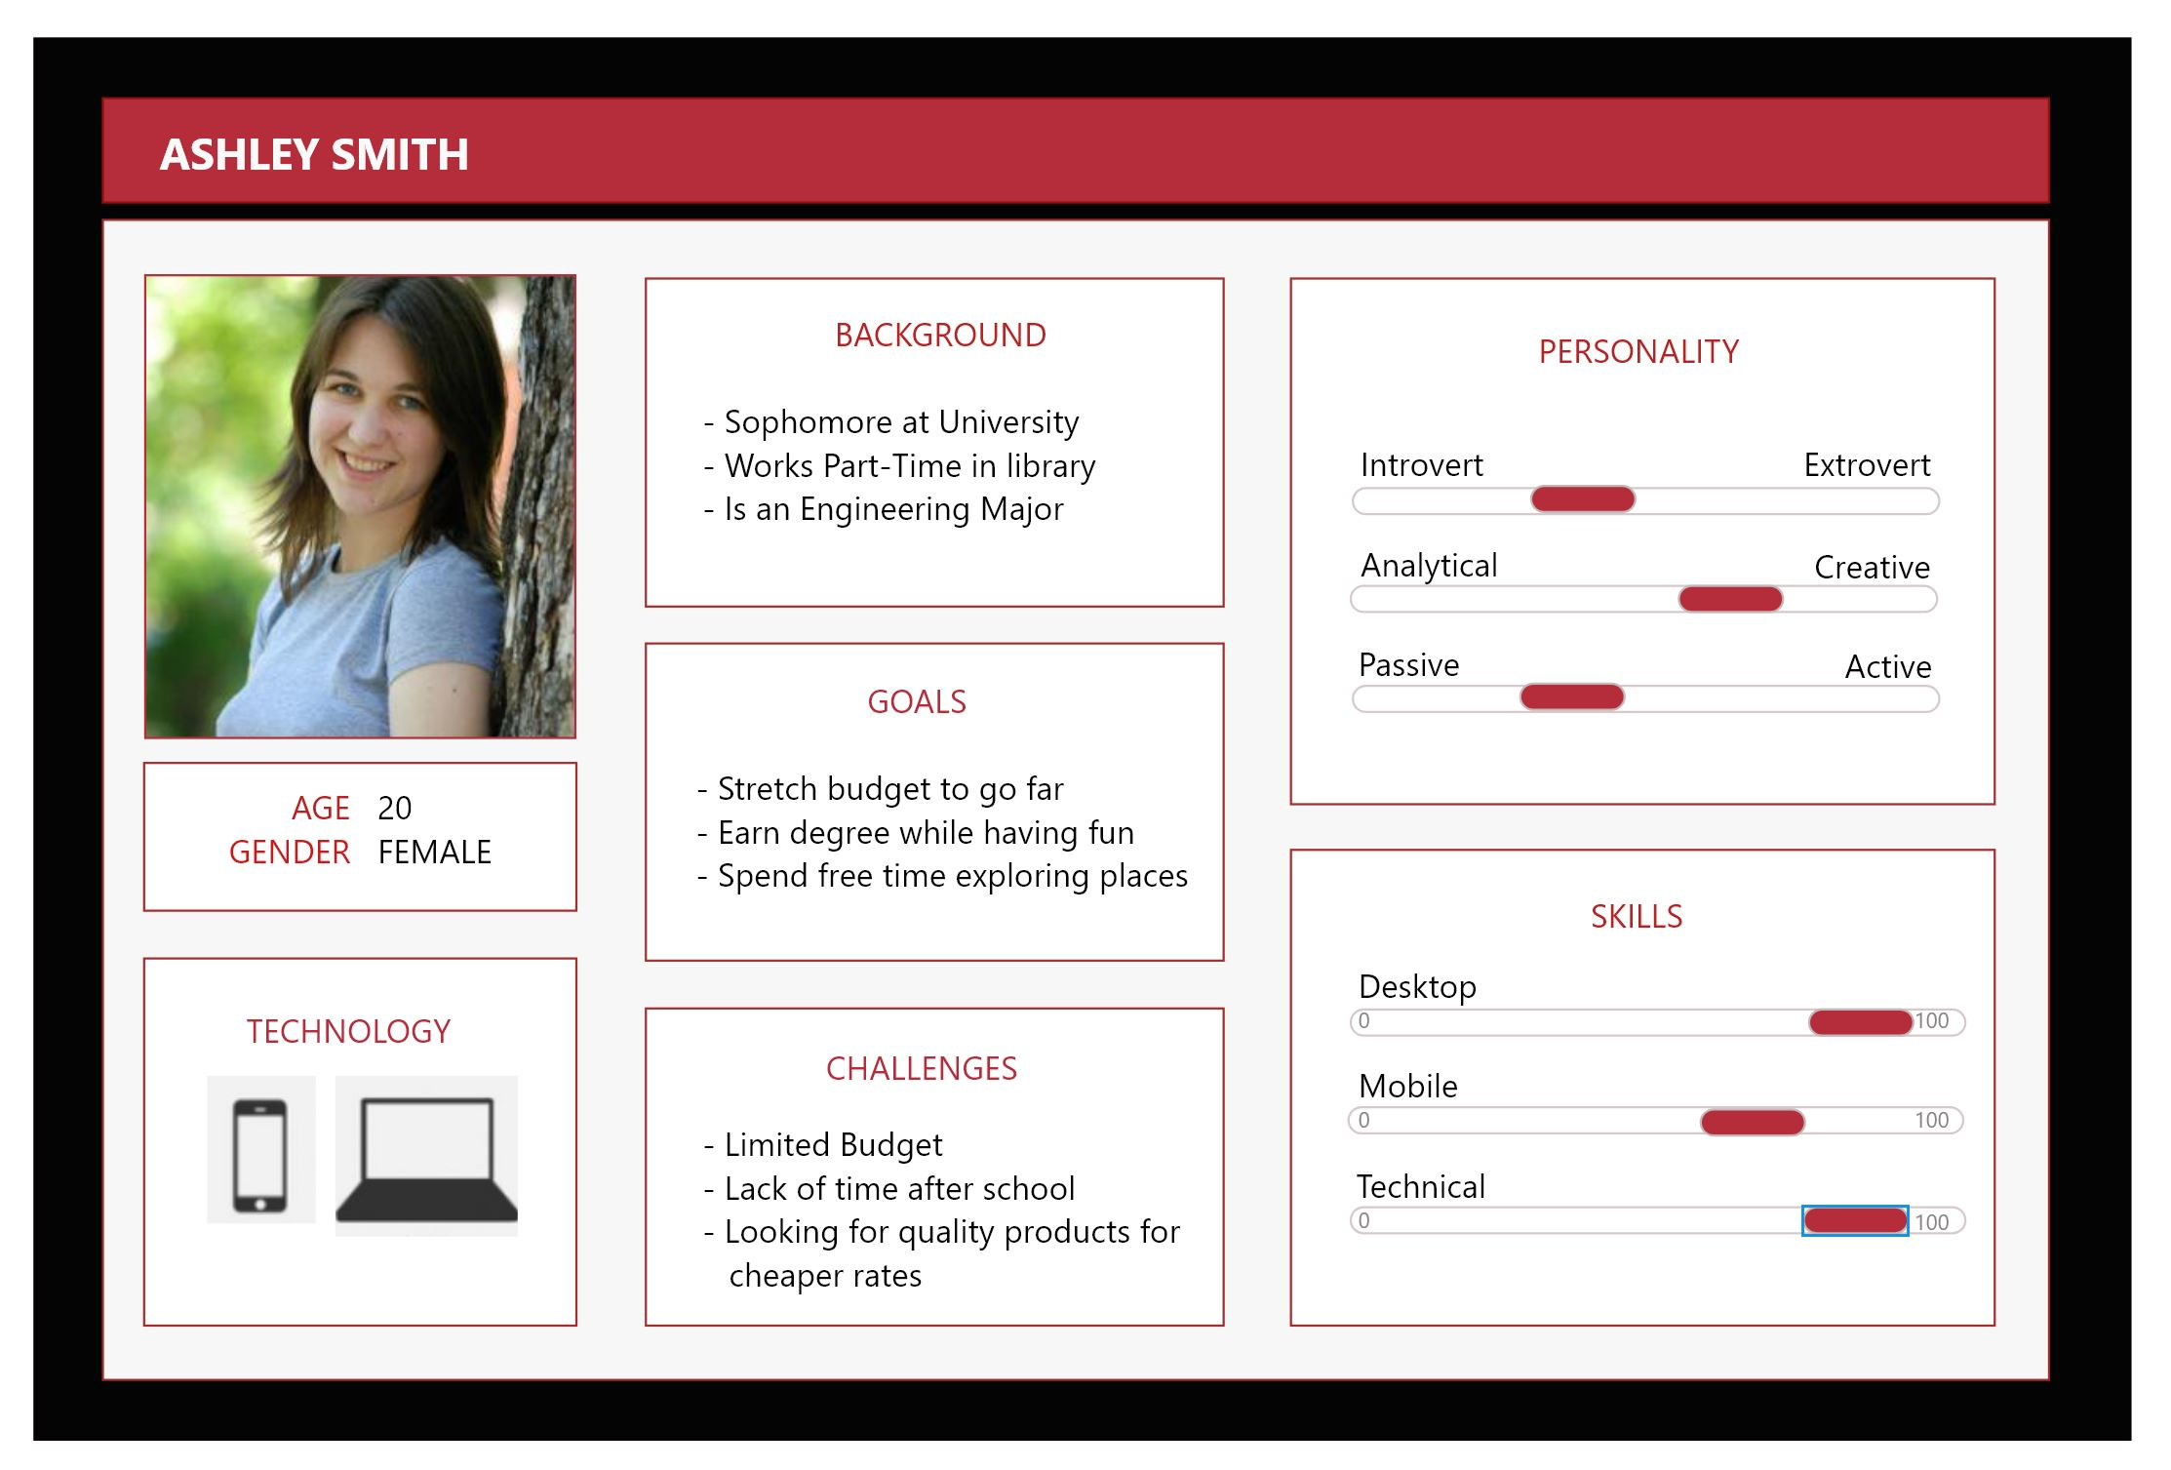

Slide 11
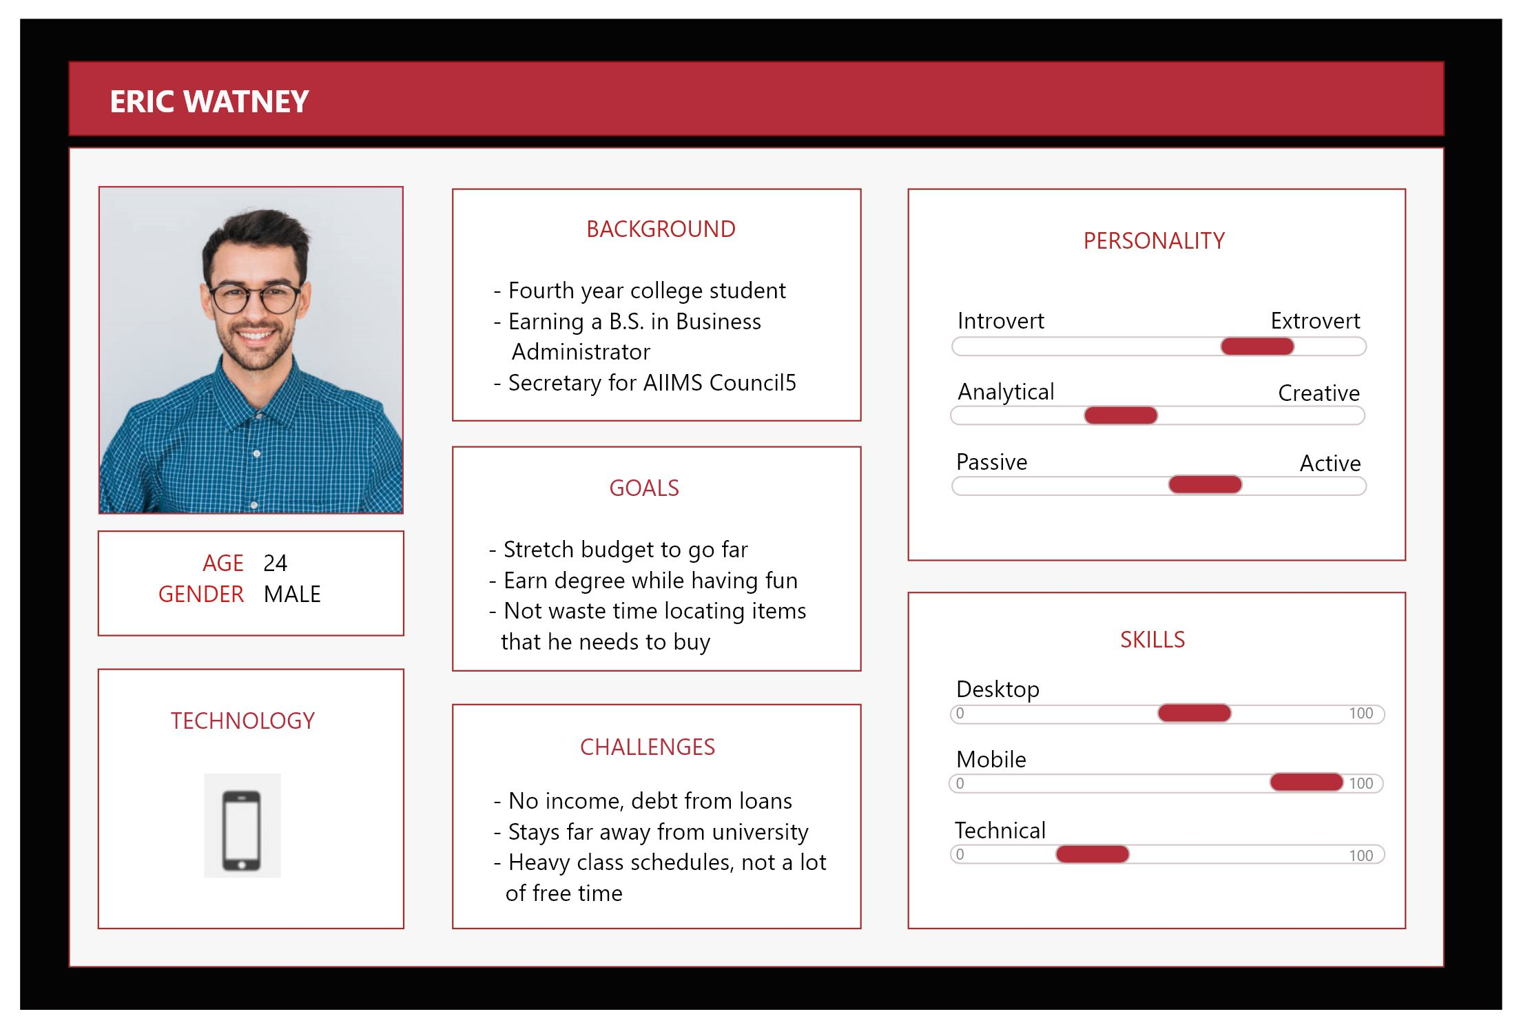

Slide 12
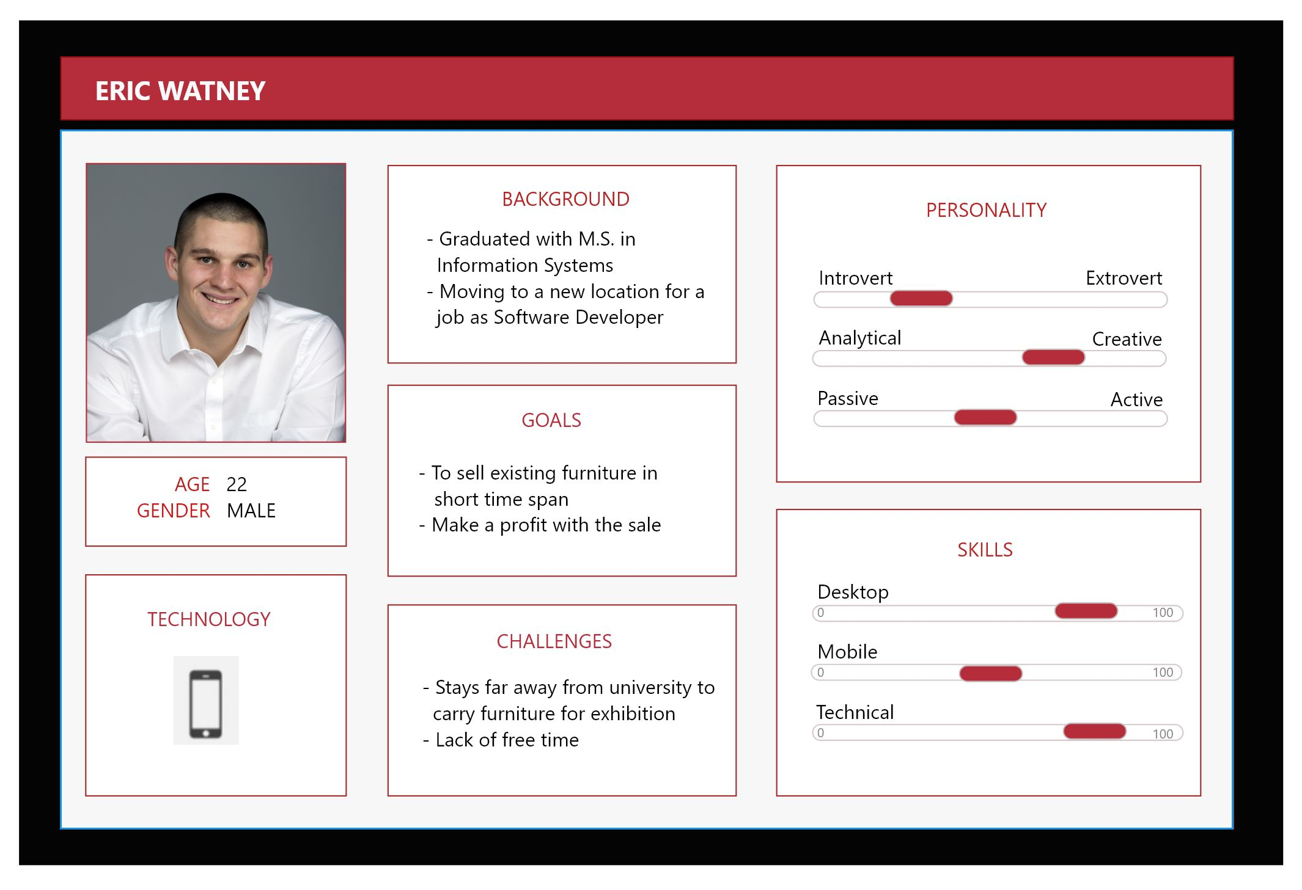


Slide 13
SCOPE PLANE

Slide 14
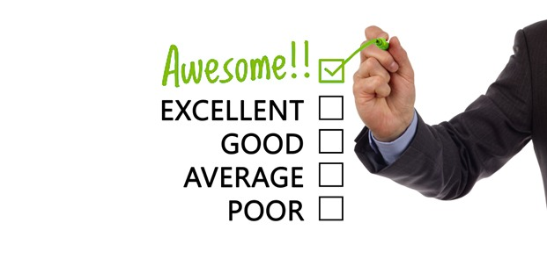
Functional specifications
Attractive, easy to navigate web store design
Speedy page loading
Search and filters
Customer reviews
Smooth and simple checkout
Visible contact information for customer service
Request for trolley
Auction on the items

Slide 15
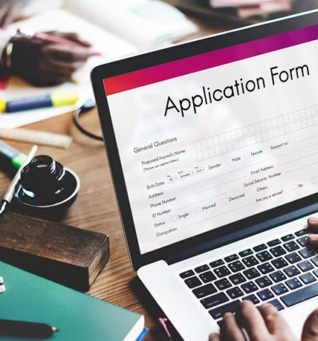
Content specifications
Sign up and login: Application should allow the user to create an account using the husky email id and user should be able to log out and log back
User onboarding: New user should get a quick tour of the application as a part of user onboarding process
Fundamental features: User should be able to use both fundamental features of the application i.e buying and selling
View profile: User should be able to view and edit their own profile
Feedback features: User can provide the feedback which can be viewed by the admin of the application
Alerts on action: User should be notified on each of their actions

Slide 16
Seller specific requirement
Admin specific requirement
Provide the pricing and other requirement effortlessly
Select from different categories
Edit the item details and save the changes smoothly
Modify the orders and change the order status
Add, update and delete the items and users of the application
Control the time and price of the items present in the auction.
View the feedbacks provided by the user
Manage the order details and be able to change the status of the order accordingly

Slide 17
Buyer specific requirement
Starting with the attractive home page, buyer can navigate to the list of items present on PawShop
Search for items on the application
Add the desired item into the Wishlist or cart which can be viewed at any point
View the items and buy the item straight away or add the item to the shopping cart to continue shopping other items
Items in the shopping cart can be removed or added to the Wishlist
Checkout the items present in the shopping cart
Get multiple payment options
Prompted with the alert message after the order is placed
View the invoices once the order is placed

Slide 18
STRUCTURE PLANE

Slide 19
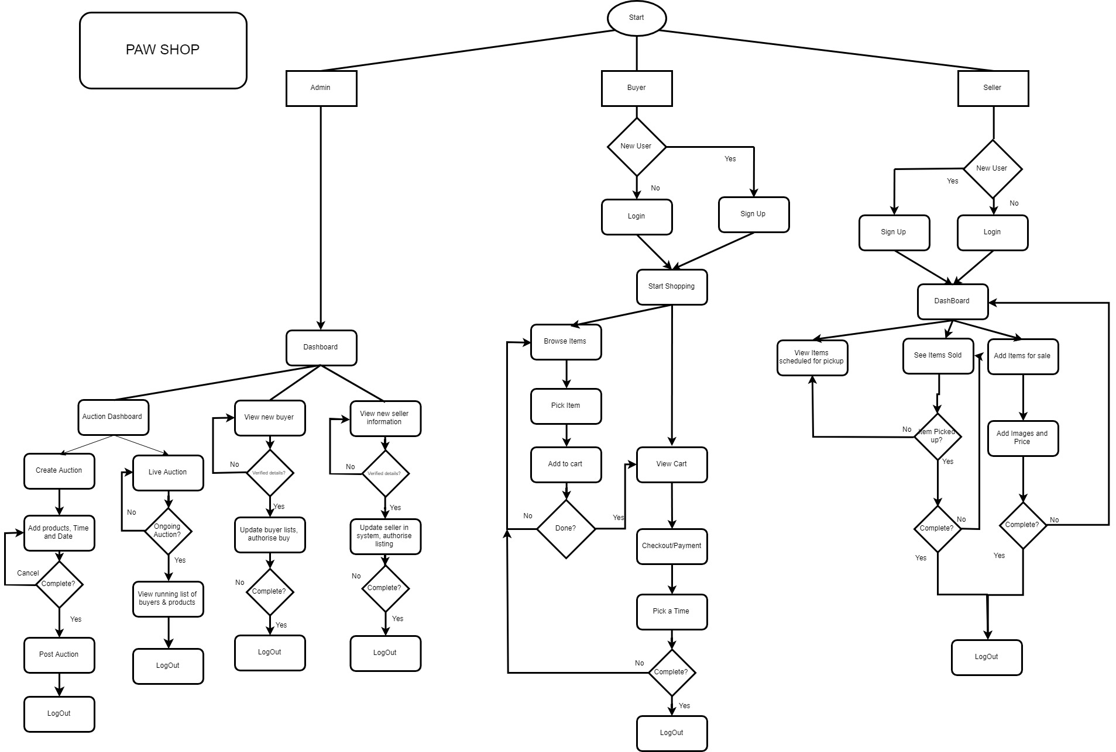

Slide 20
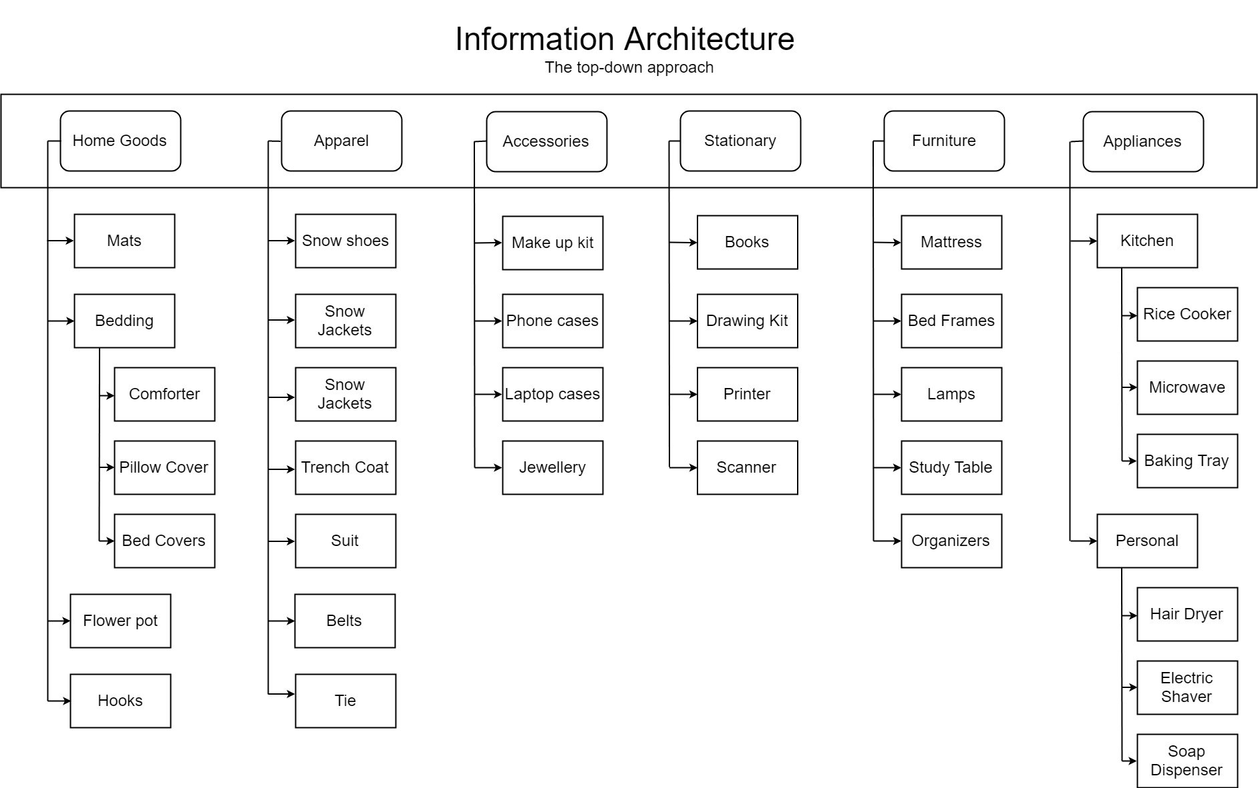

Slide 21
SURFACE PLANE

Slide 22
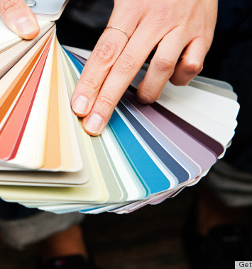
What is included in a surface plane?
It’s the sum total of all the work and decisions we have made. It determines how does the product will look like, and choosing the right layout, typography, colors, …etc.
We have selected color combination as RED and WHITE since it matches the theme of any northeastern website

Slide 23
UX Research Methods

Slide 24
SURVEY
https://goo.gl/forms/X3VFl9G0cC2TB44i1

Slide 25
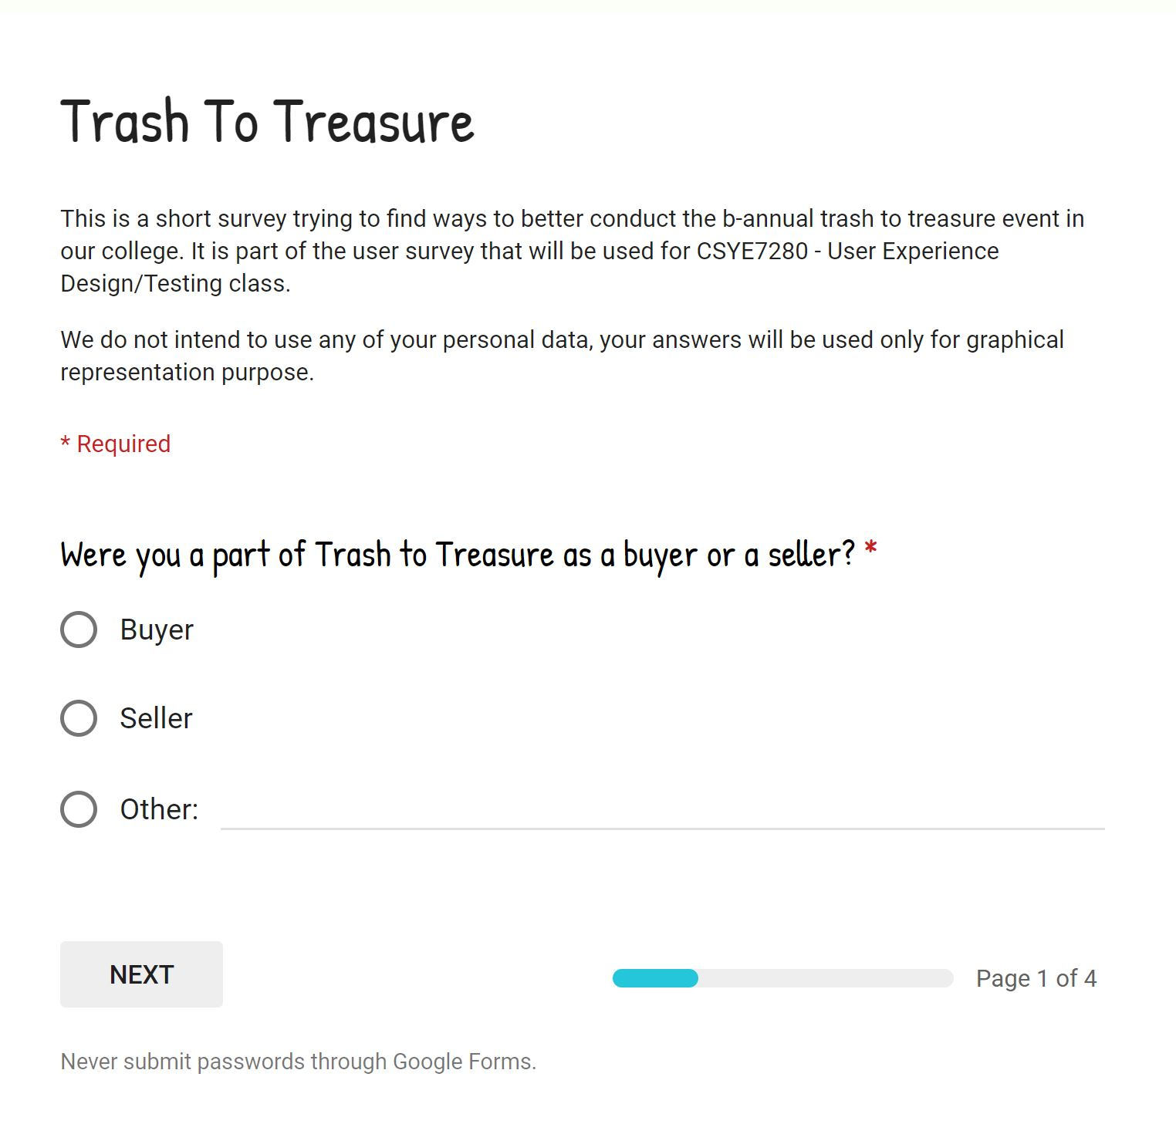
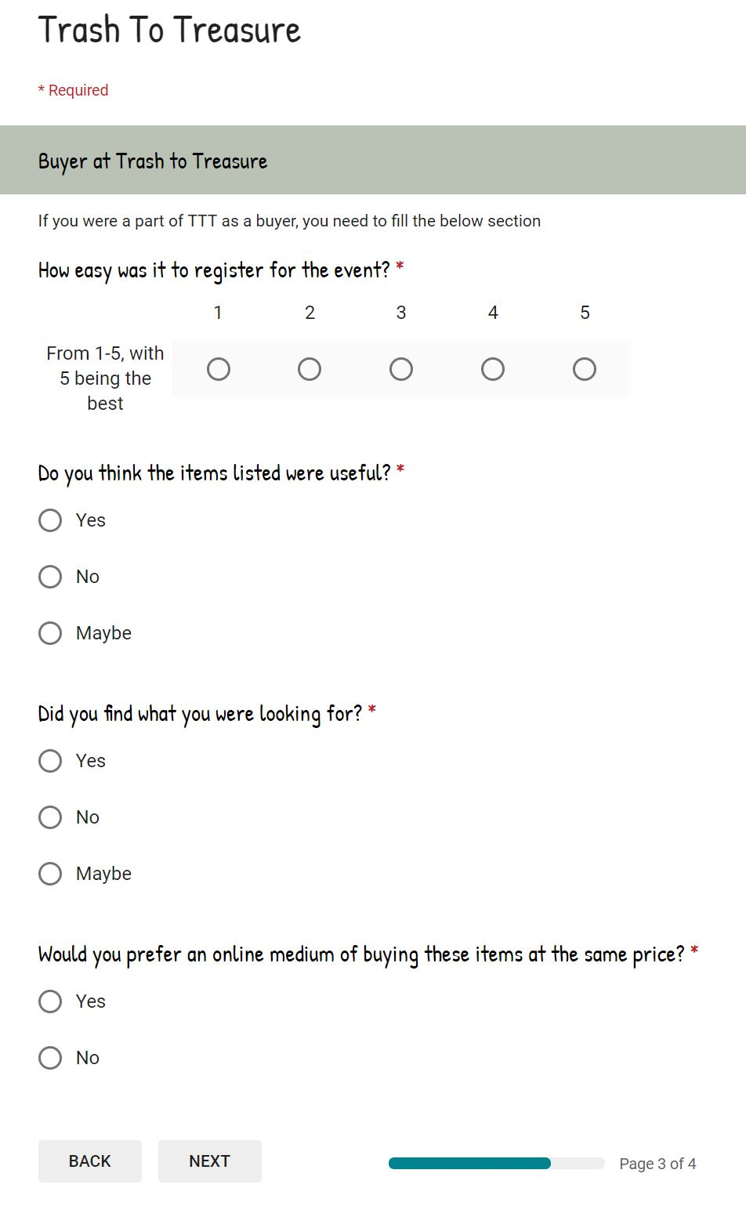
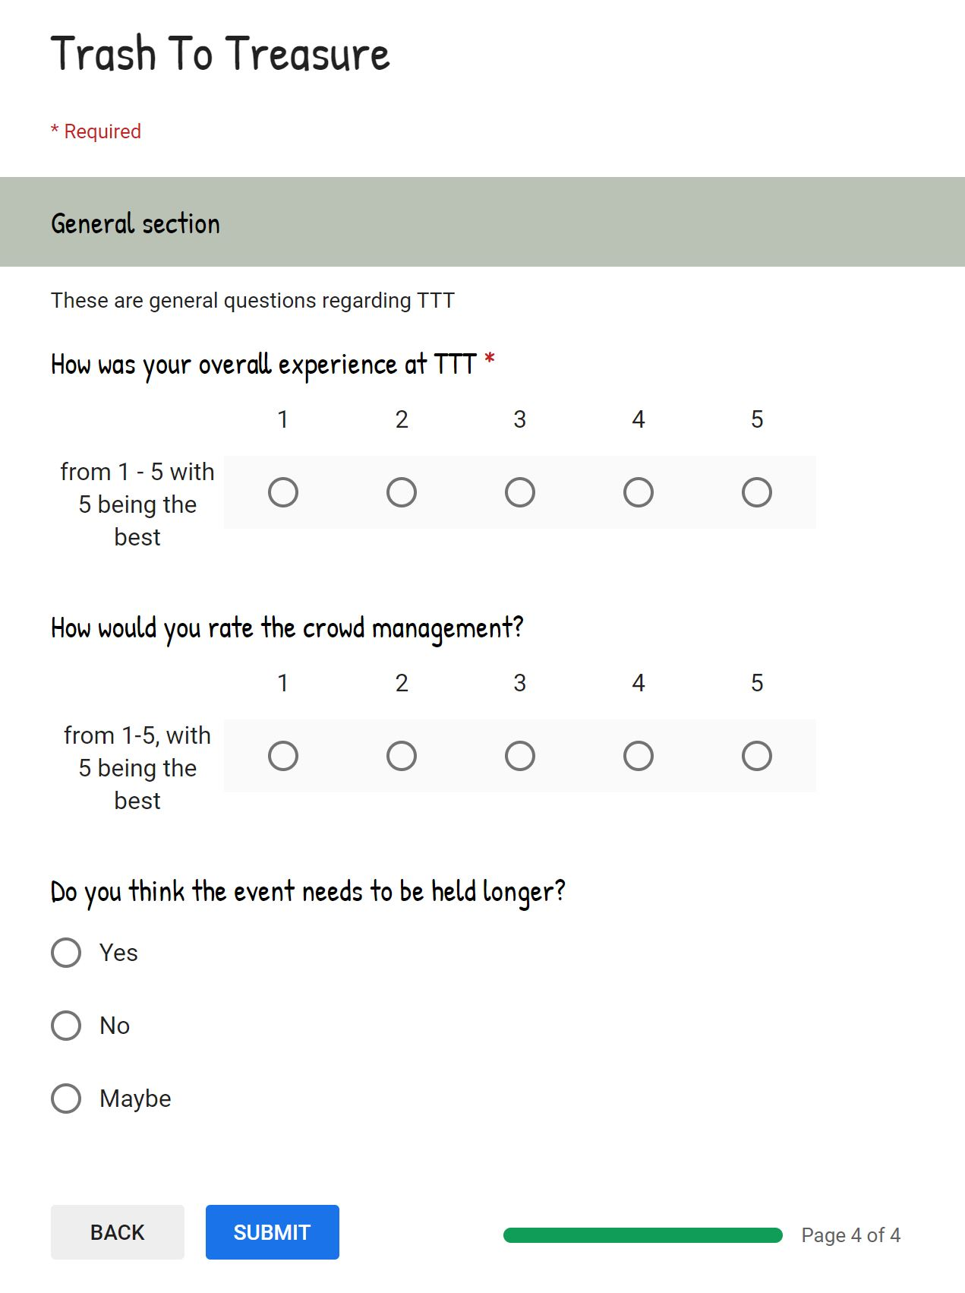
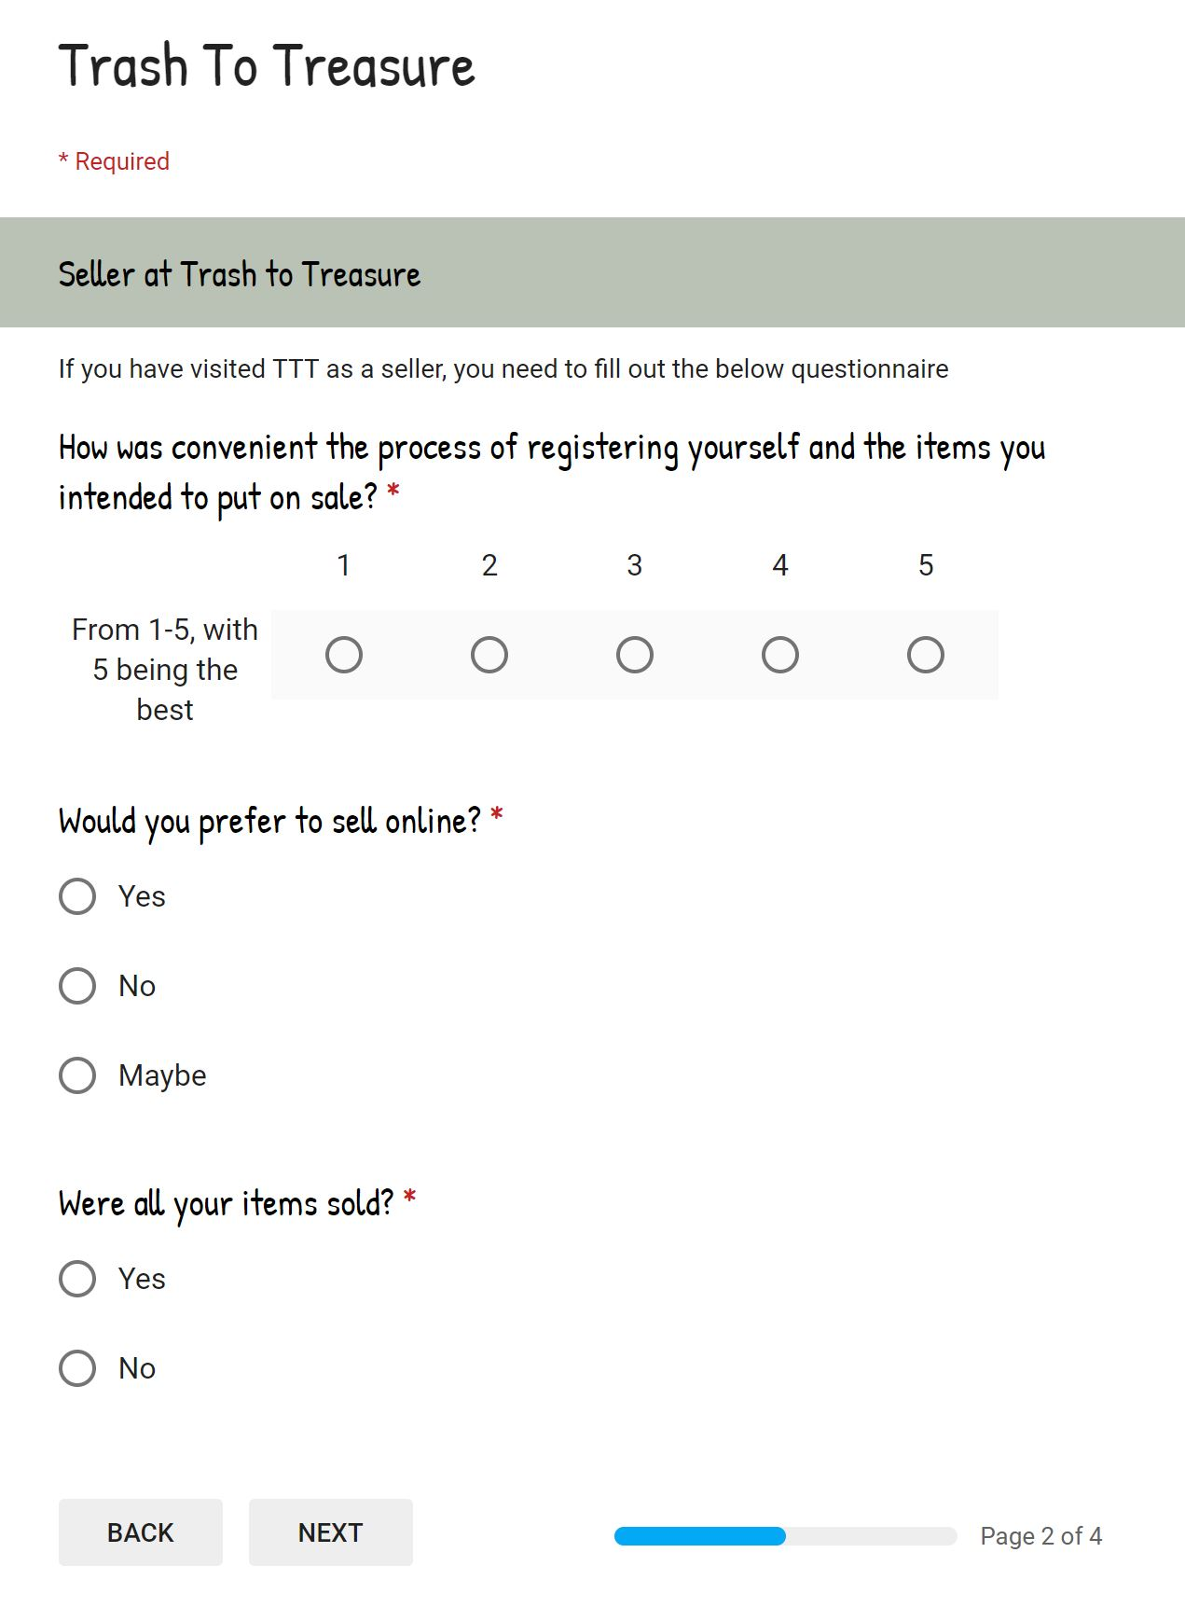

Slide 26
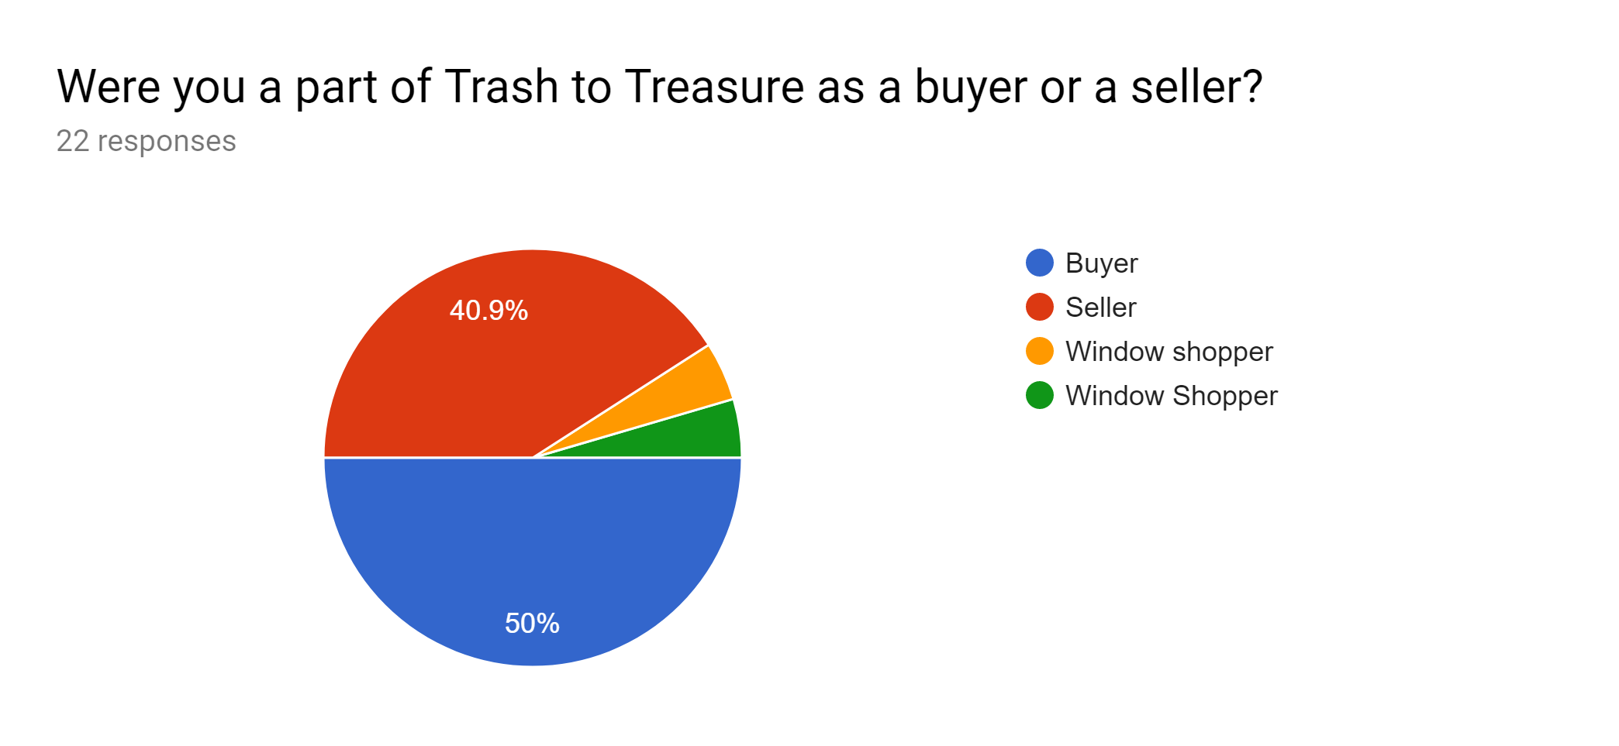
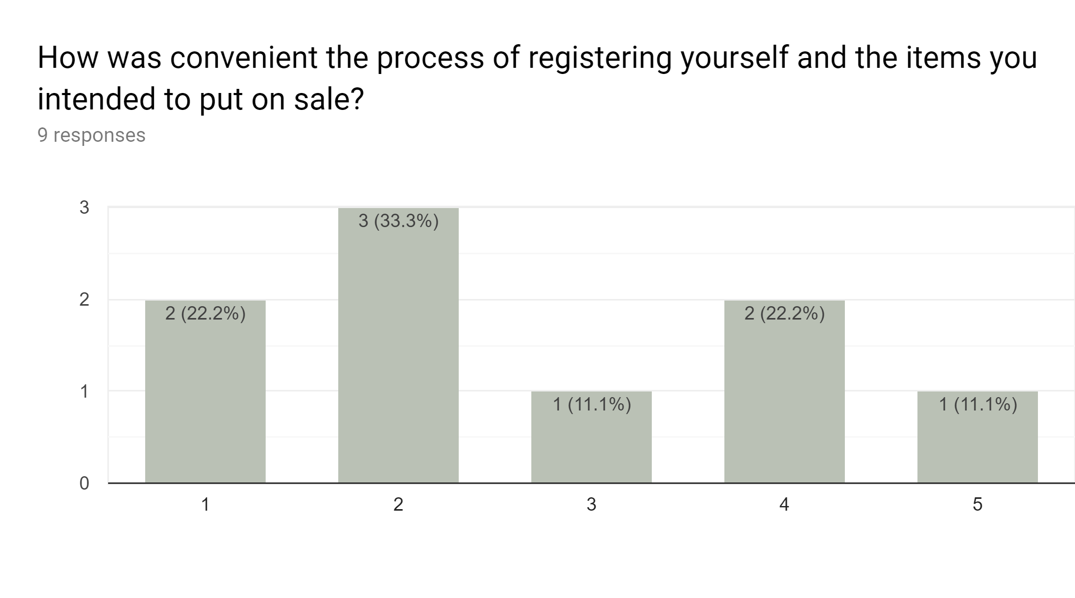
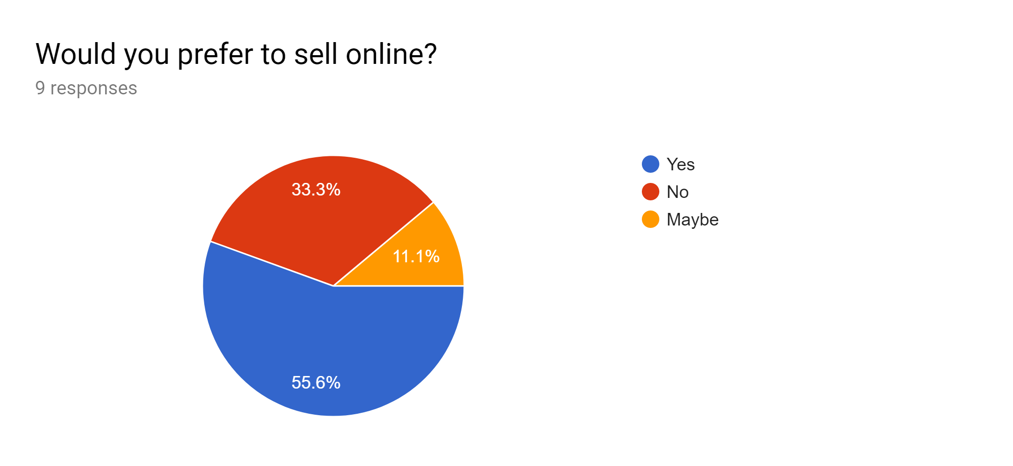
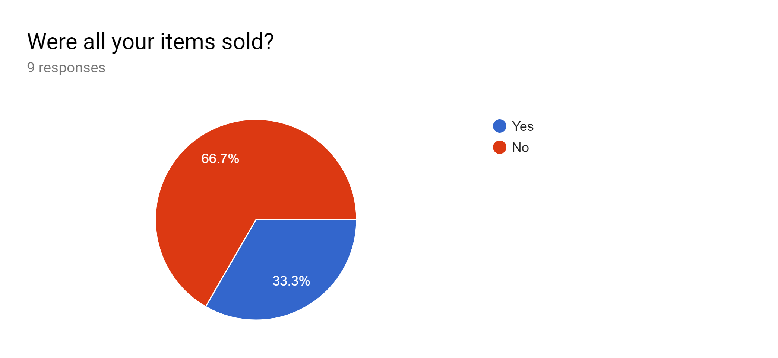

Slide 27
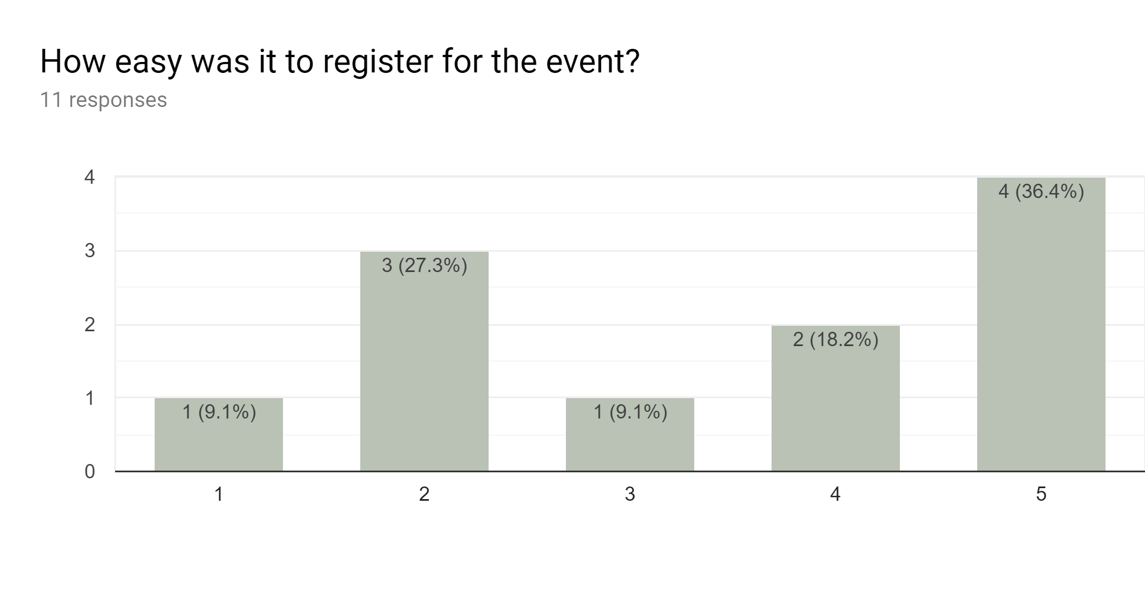
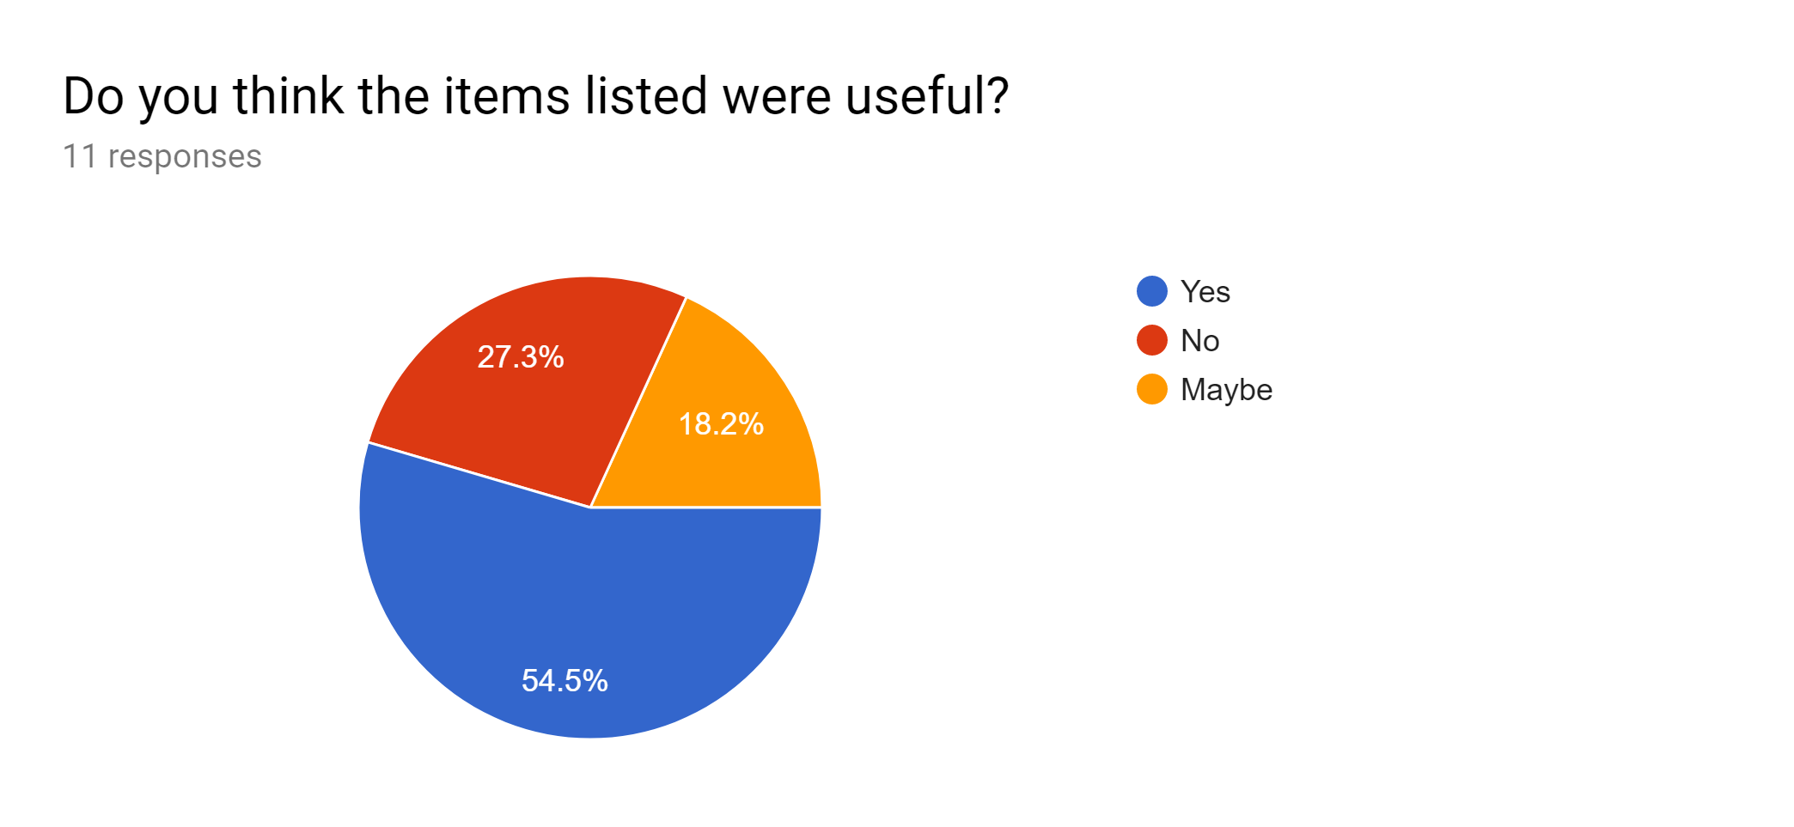
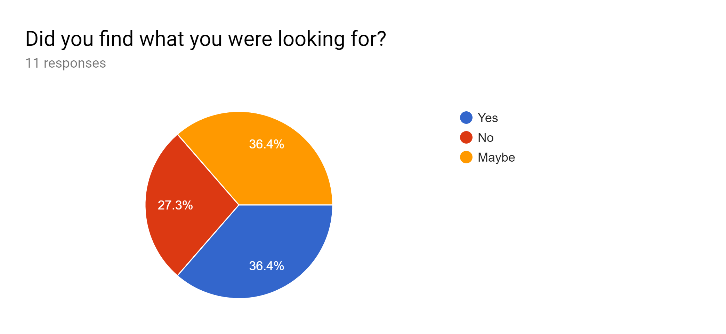
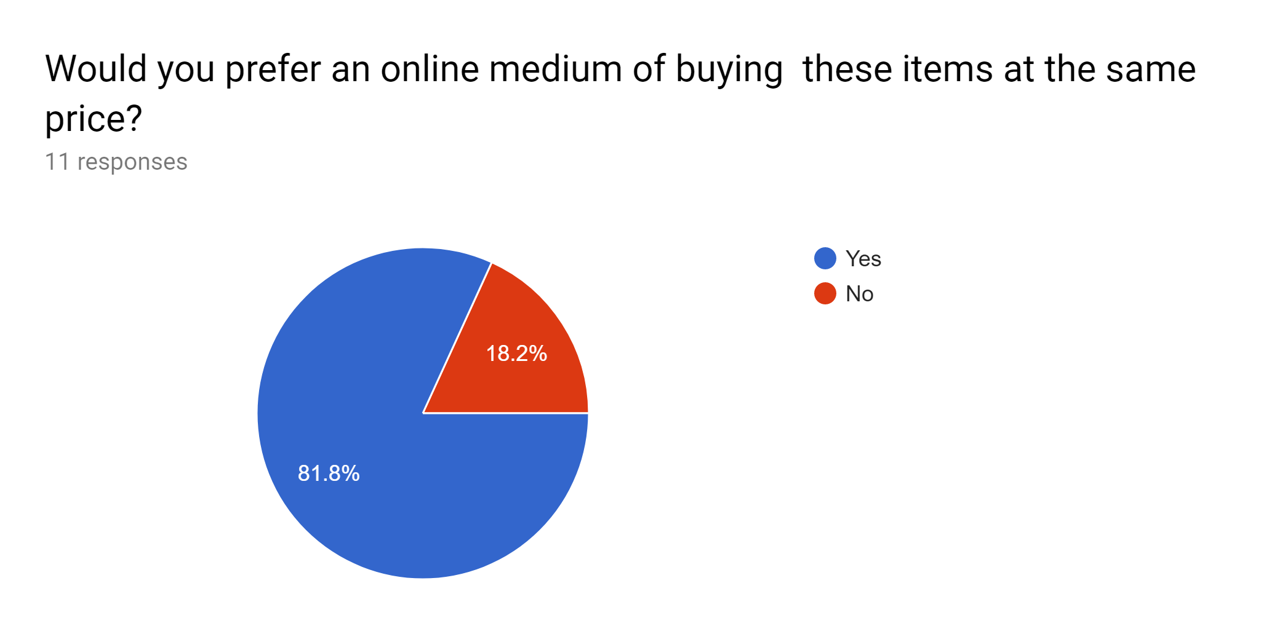

Slide 28
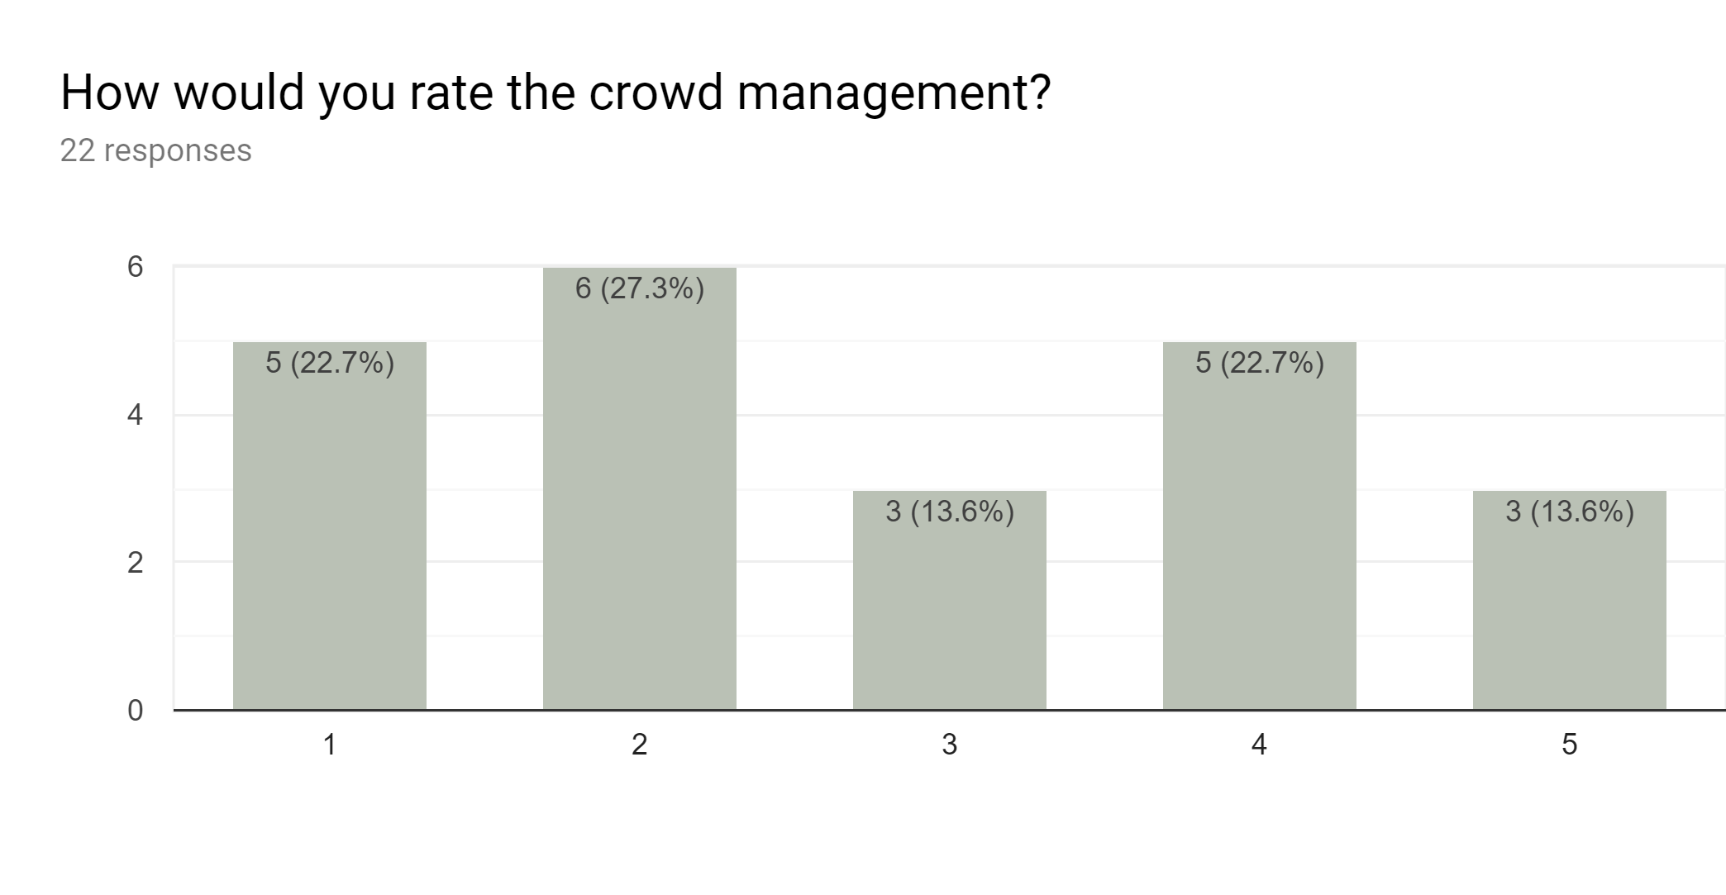
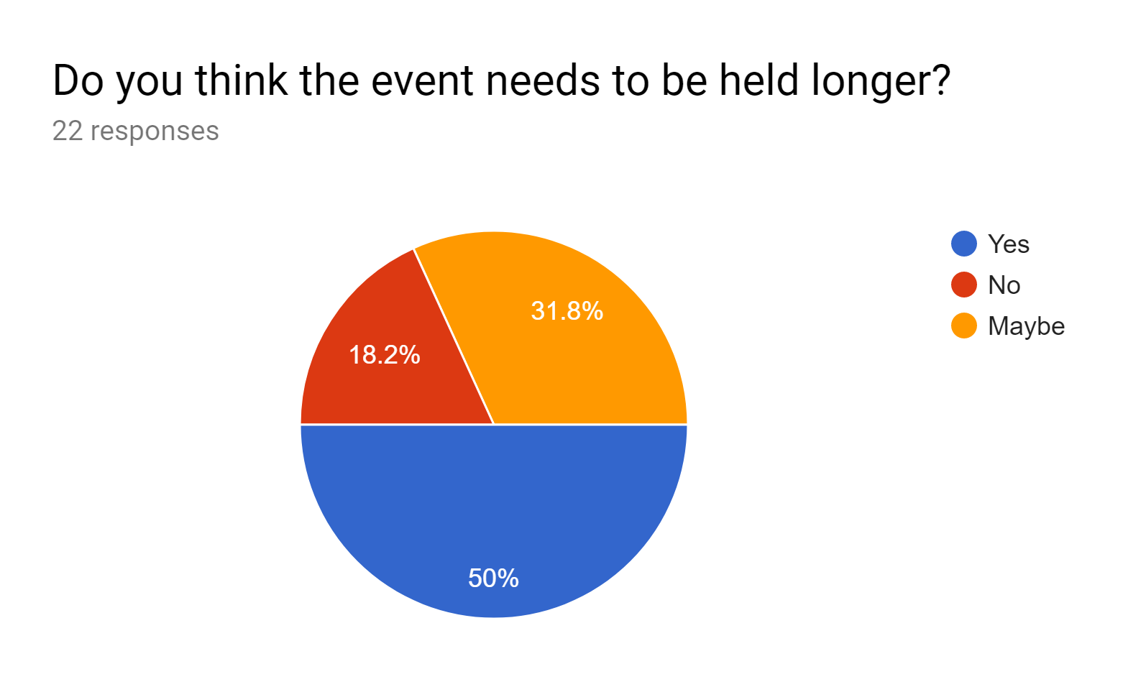
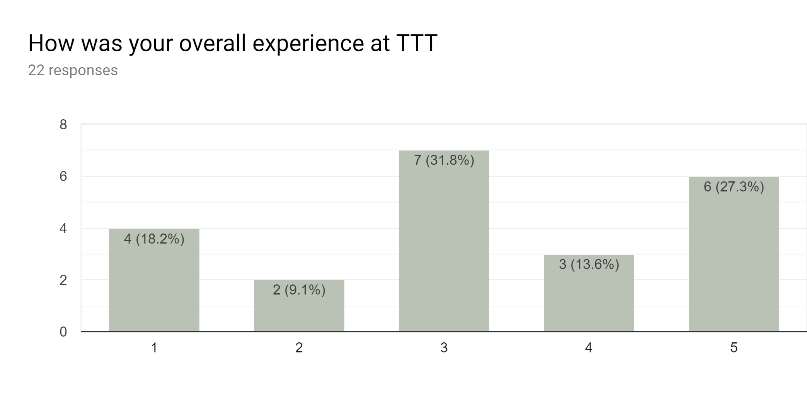

Slide 29
CONCEPT TESTING

Slide 30

We conducted this to get feedback from the user on our idea in the early stages. The idea was communicated and responses were addressed
The concept of Trash to Treasure was formed after this it helped us jot down the requirements needed to move forward with the prototyping.
We spoke to a group of individuals and understood the most essential functionalities which would be required.
It helped us gain insight around whether customers understood the idea and would want to use the product or feature.

Slide 31
FOCUS GROUP

Slide 32

Focus group consisted of 7 participants and 1 moderated.
It consisted students from Northeastern who have already participated in Trash to Treasure and new joiners.
It was conducted to understand the user perspective and gauge the requirements from the users from the prototype.
Moderator: Rohit Naik
Nikunj Doshi
Balaji Mudaliar
Varsha Premani
Utkarsha Pampatvar
Ujjawal Gautam
Lakshit Talreja
Rishi Jatania

Slide 33
MODERATED USER TESTING

Slide 34
Moderated user testing was conducted to gain real time responses to the tasks the users were asked to perform.
The questions asked and responses received :
Journey was asked to be preformed:
Search a product
Find a product
Buy the product
How easy was it to register as a new user?
The process of creating a new user was really simple as we had to register with our college login and NUID, thus helping us skip the process of having to fill out the personal details
What did you like about the product selection and categories?
The product selection ranged from furniture to personal care. Everything that was present in the Trash to Treasure event was covered in the application. The bifurcation in categories helps for easy navigation to find the desired products without having to navigate through the entire the application.

Slide 35
How easy was it to checkout the product? Would you like more options for payment than the ones specified?
Yes, The option to be able to pay with the NU Card makes it really convenient for faster checkout. But it would be great to have an option to add a Debit/Credit Card, Venmo for personal preferences.
Would you like the option to buy more product quantity than the quantity per person specified?
Yes, It would be great to be able to buy more product as the user could have more requirements for a particular product, plus the exact amount is charged without any discount which should not cause any problem.
Would you like the option to contact the user?
Yes, With the option of collecting the product from the user, if the user is running late, the option to let the seller know this without having to lose out on the product.
Any suggestions regarding the color scheme.
The color scheme works well with the college theme.

Slide 36
CARD SORTING

Slide 37
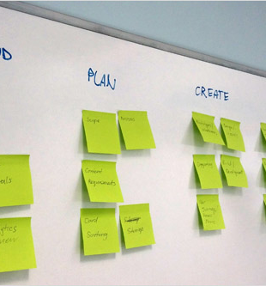
We applied card sorting technique to identify what users are expecting and want us to have in the App.
It is used to develop the better and more user centric Information Architecture.
We asked around 20 people in groups of 10 to take part in this usability testing method.
Our cards consisted mainly of categorized items and scope of the application.
Based on the users way of sorting the cards and the feedback given, we figured out what they were expecting from The PawShop and designed the App accordingly.

Slide 38
LEARNINGS FROM GUEST LECTURER

Slide 39
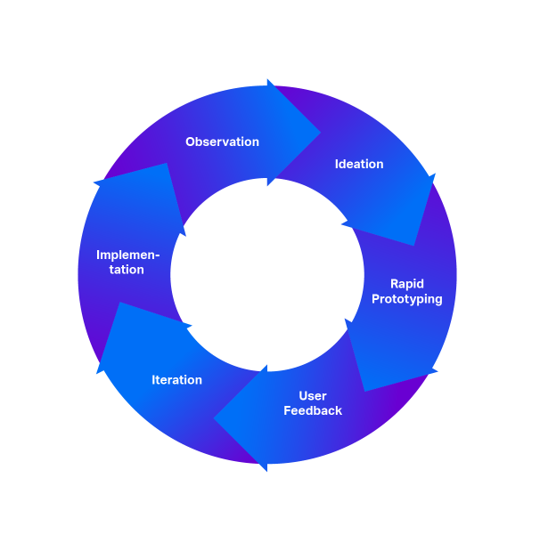
Three magical questions
1. Who is our Target Audience?
--- Northeastern Students
2. What are we making and why?
--- A Mobile App to make Trash2Treasure easy.
3. What will success look like?
--- Seeing students happy buying the much needed stuff for their houses and for themselves.
Human-Centered Design Approach

Slide 40
SKELETON PLANE
WIREFRAMES
Mocqups: https://pawshop.netlify.com/
Axure: https://thepawshop.netlify.com/

Slide 41
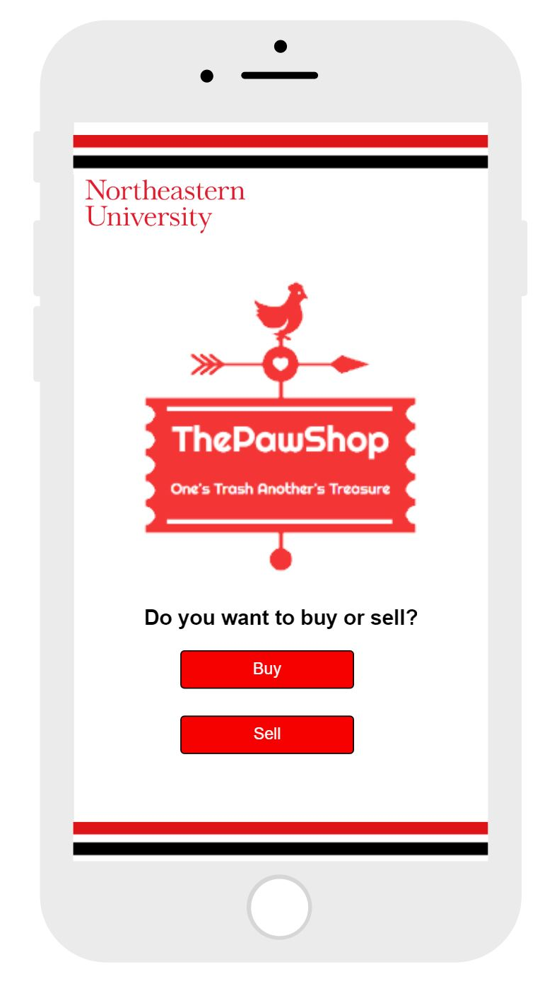
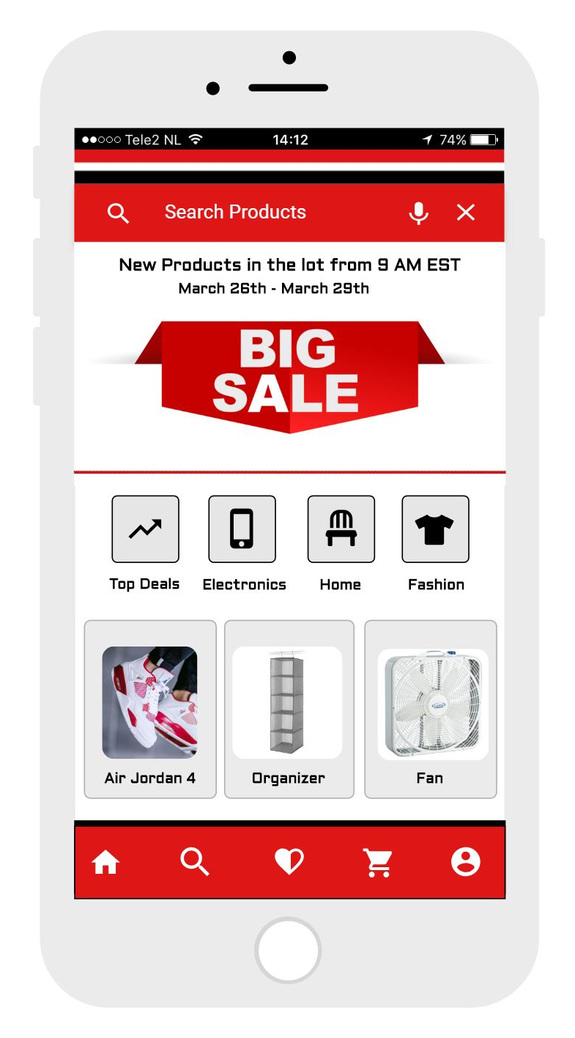
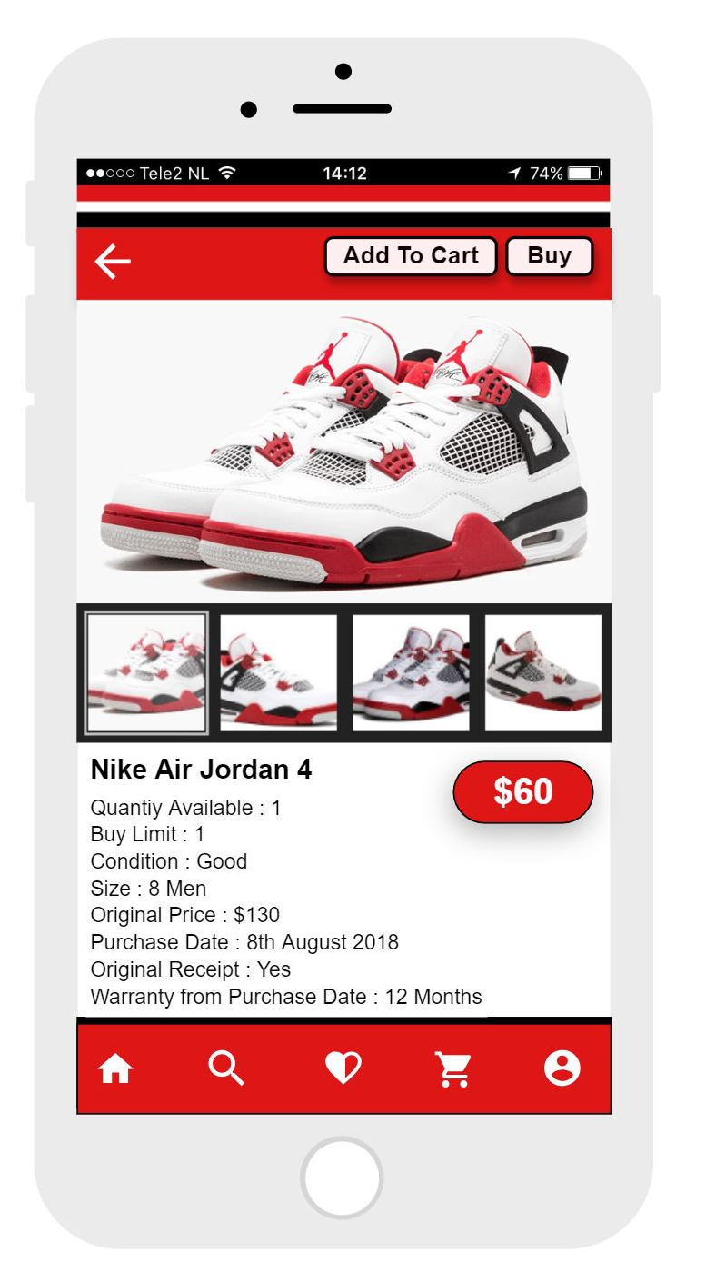

Slide 42
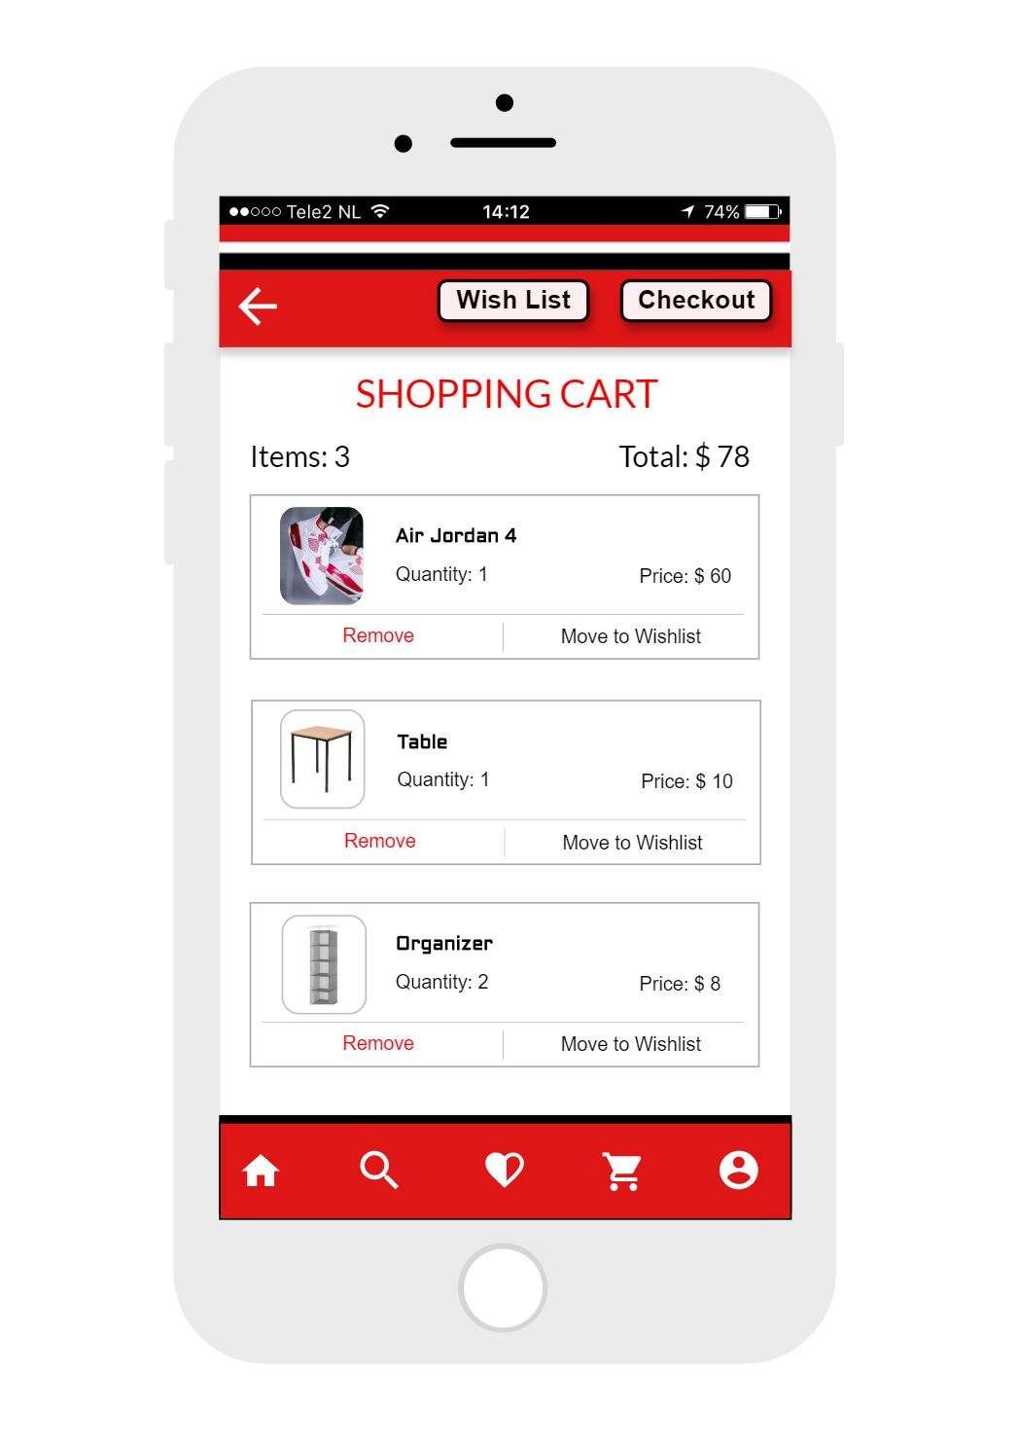
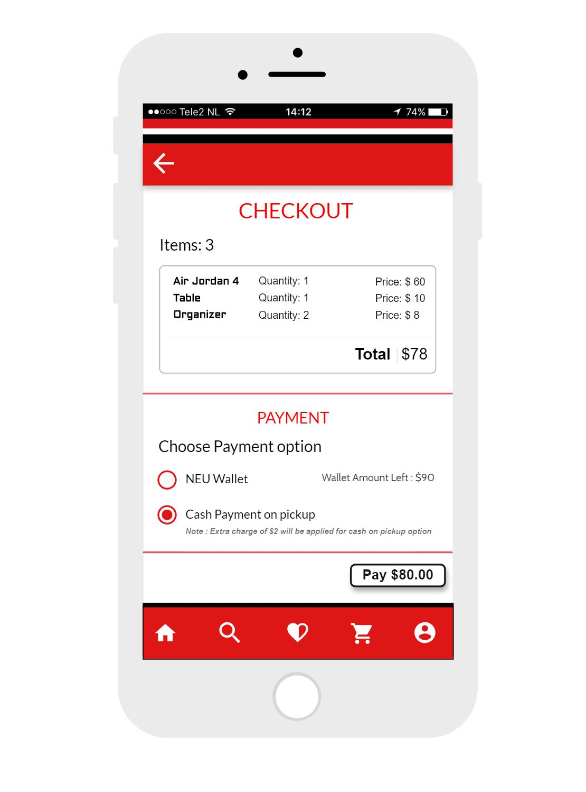
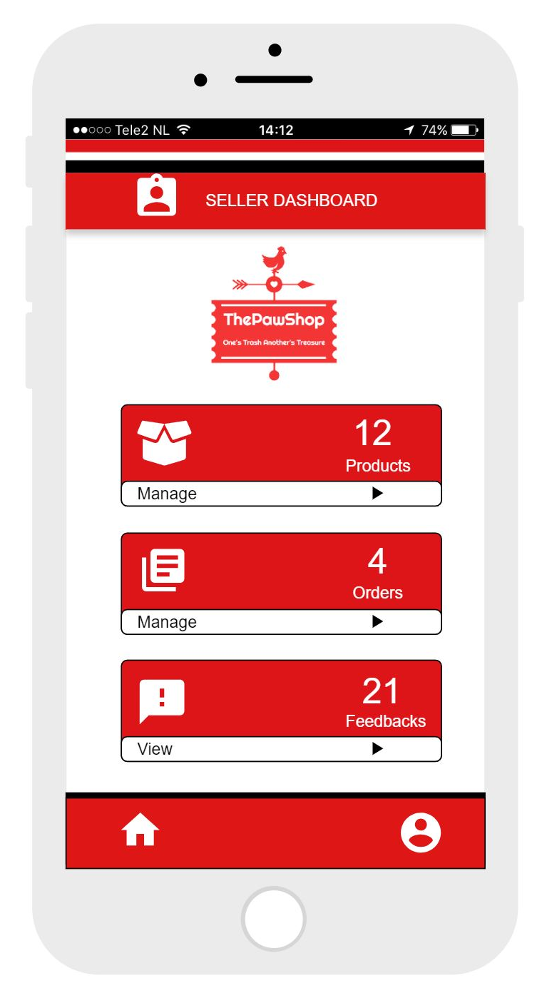

Slide 43
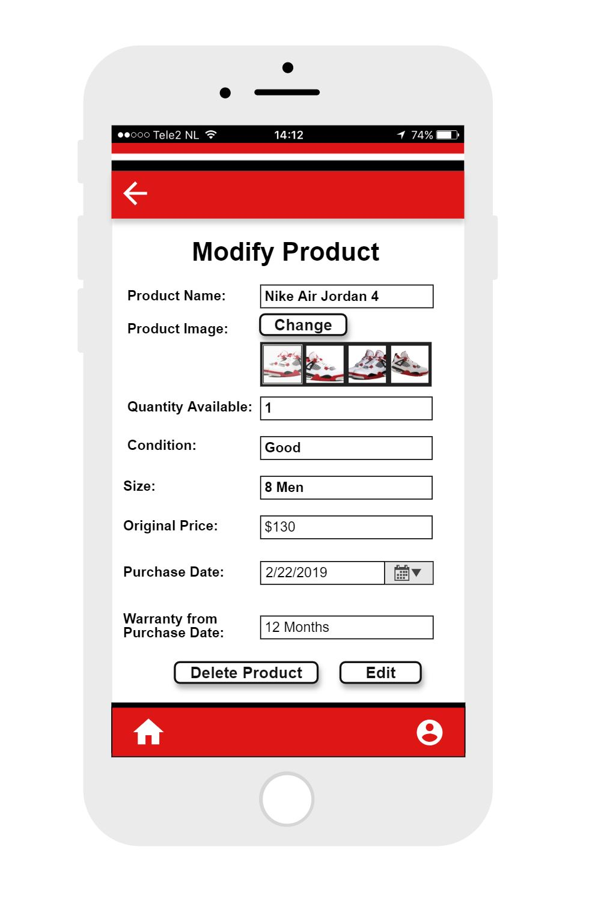
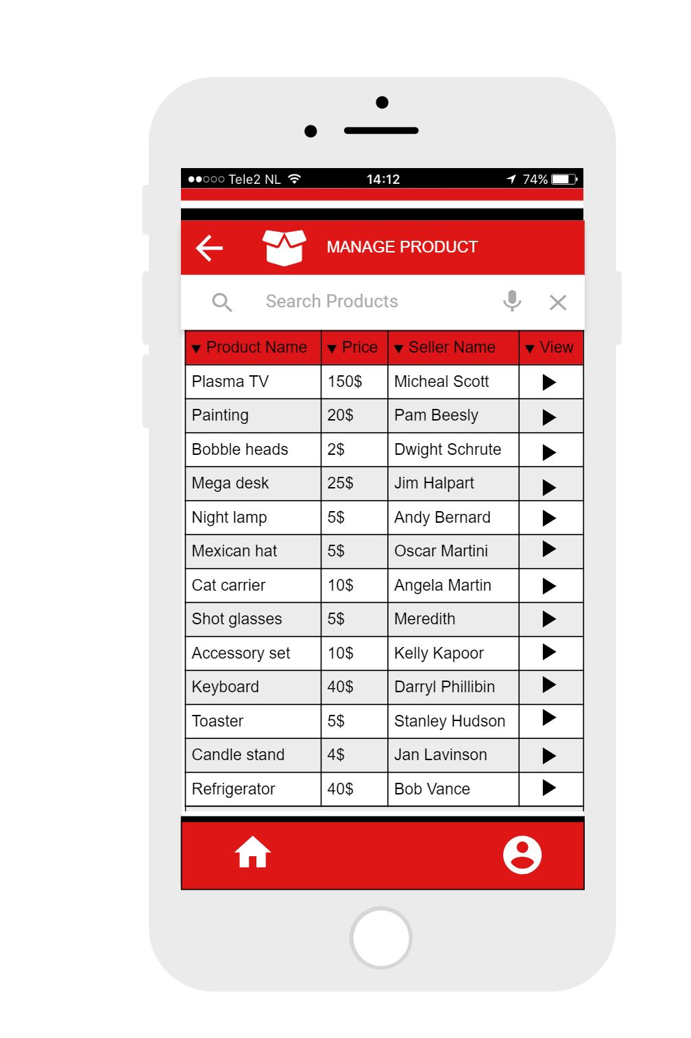
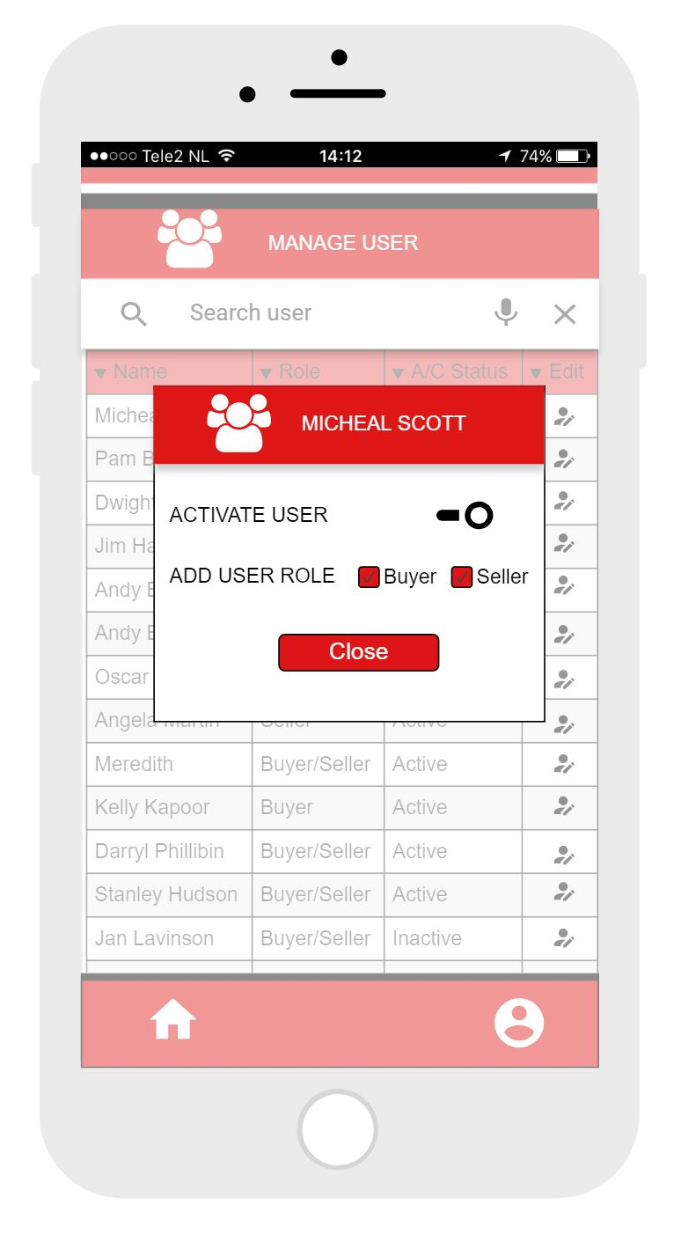

Slide 44
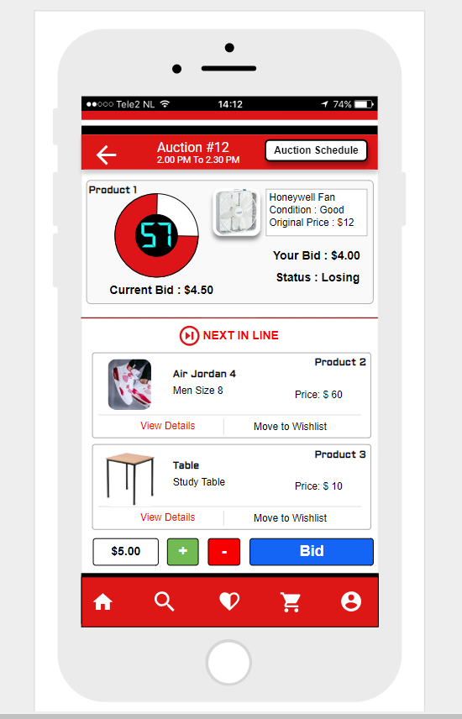
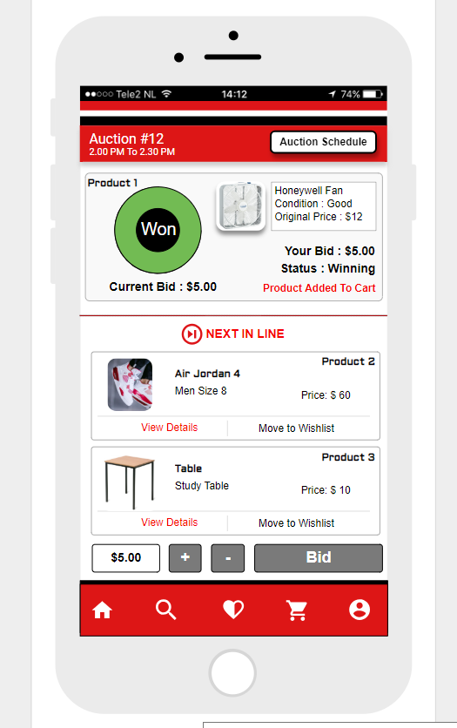
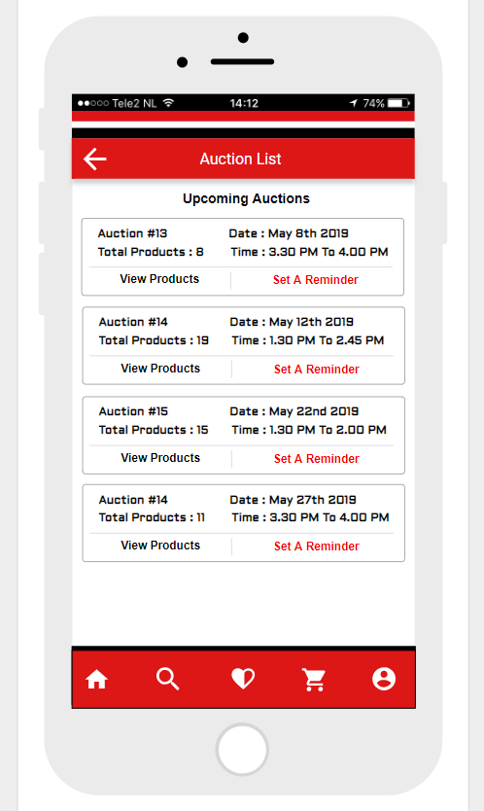

Slide 45
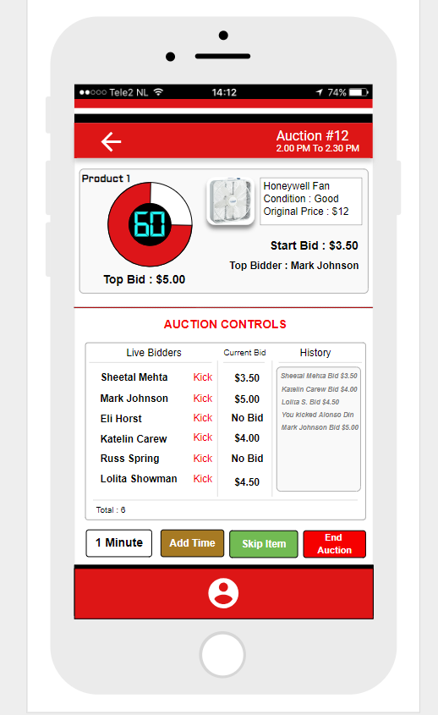
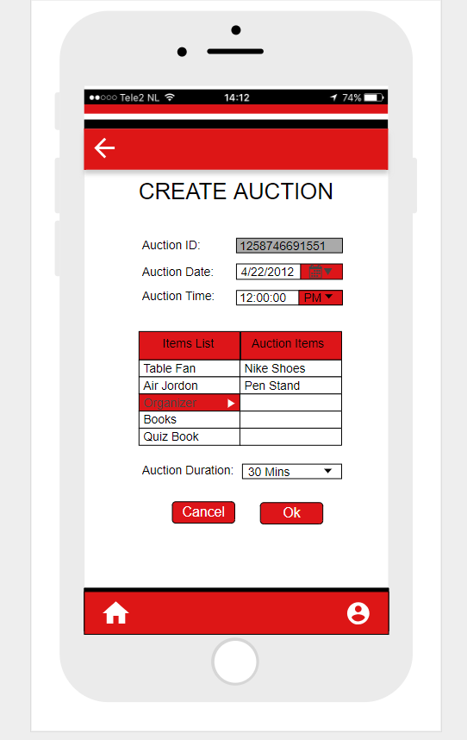
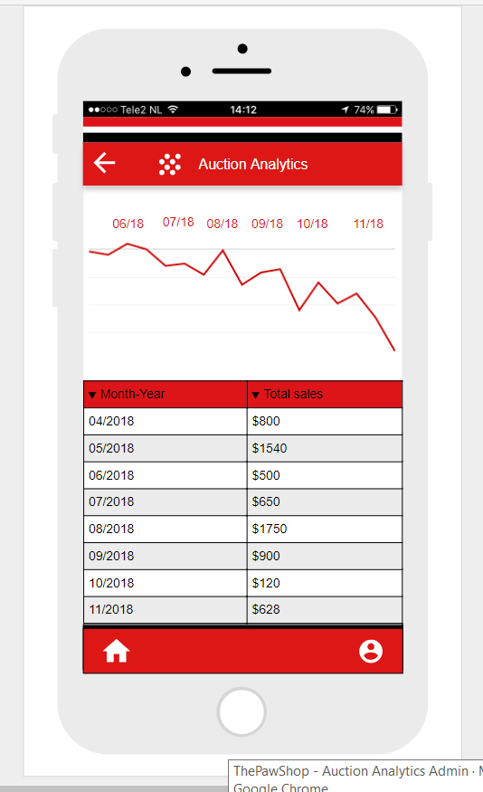

Slide 46
SELENIUM TESTING
Demo

Slide 47
MOONSHOTS

Slide 48
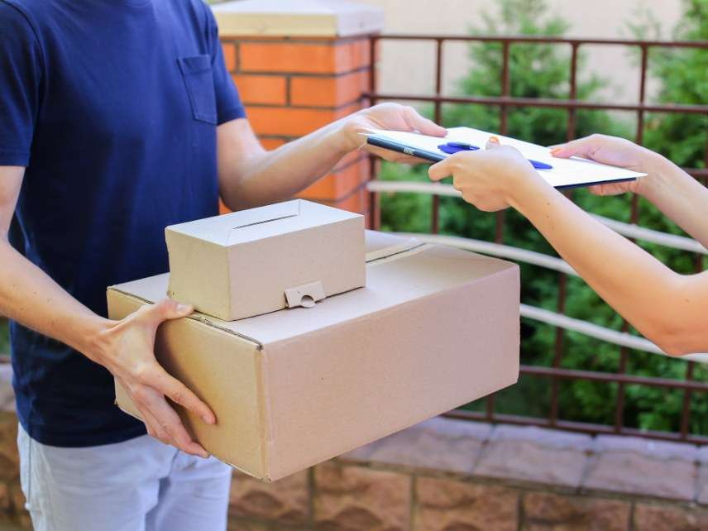
Delivery System
There are various products which are difficult to carry without a mode of transport.
We can provide an option for the seller to provide a delivery to your doorstep option.
Making it convenient for buy the product and have it delivered just like any other ecommerce website.

Slide 49
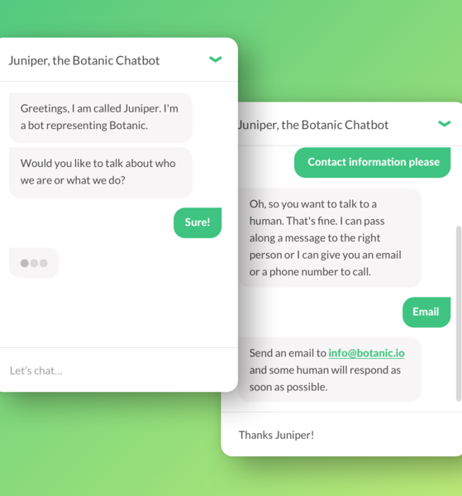
Chat Box
The buyer would be able to connect to the seller regarding the purchase made.
This can help the buyer communicate incase there is any delay for the pick up option.
The seller can contact the buyer if the seller has reached the doorstep for delivery.

Slide 50
THANK YOU
TEAM MEMBERS
Rohit Naik Suraj Nair
001832839 001407214
Tripti Rijhwani Hruda Mohod Shreya Nilangekar
001442633 001426345 001444235

